Slide 1
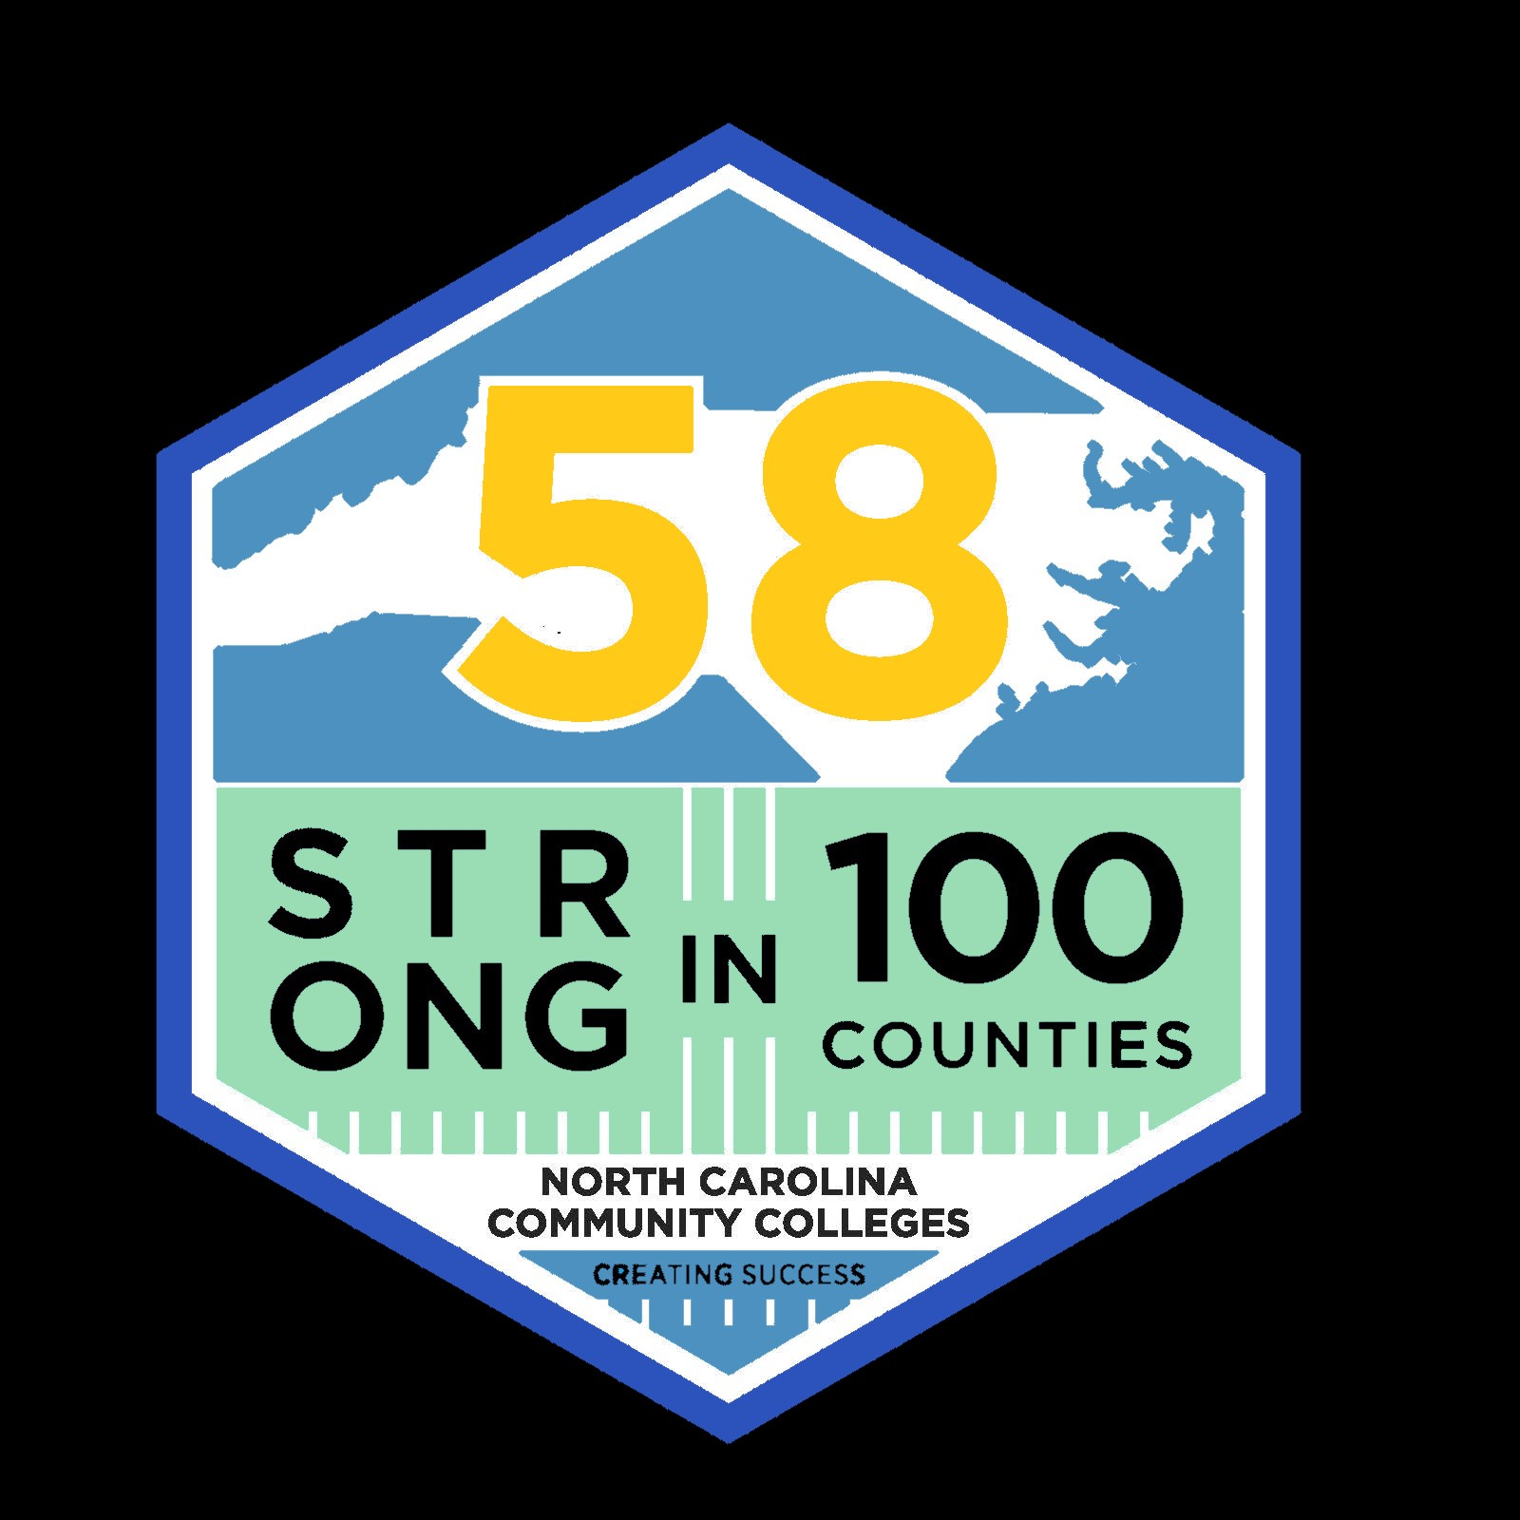
Celebrating Service Across the State
NC Community Colleges showcasing their Service to the Communities they Serve

Slide 2
NCCCS Community Service Committee
Committee Chairs:
Dr. J.W. Kelley, Associate VP
Student Services, NCCCS
Don King, Faculty/ Advisor
Pitt Community College
In 2019 a committee was formed with members from community colleges across the state. However, COVID-19 altered our plans to have a statewide Community Service Day in April of 2020. In order to still highlight the amazing service that community colleges do in the communities they serve, we are highlighting a few of the colleges across the state who did amazing campus and community service during the challenging times of the global pandemic that affected us all. Thanks to all of the colleges who shared their stories and pictures. And THANKS to you all for being such a valuable part of your community each and every day!

Slide 3
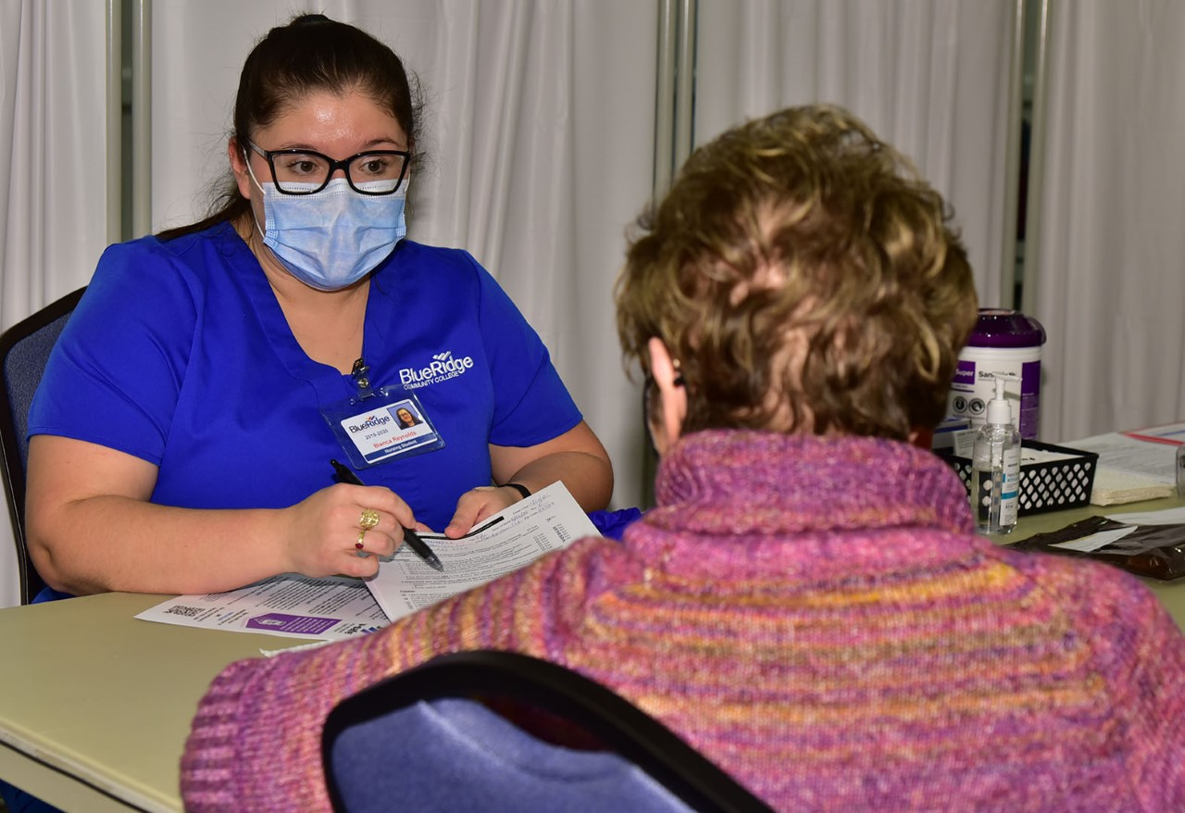
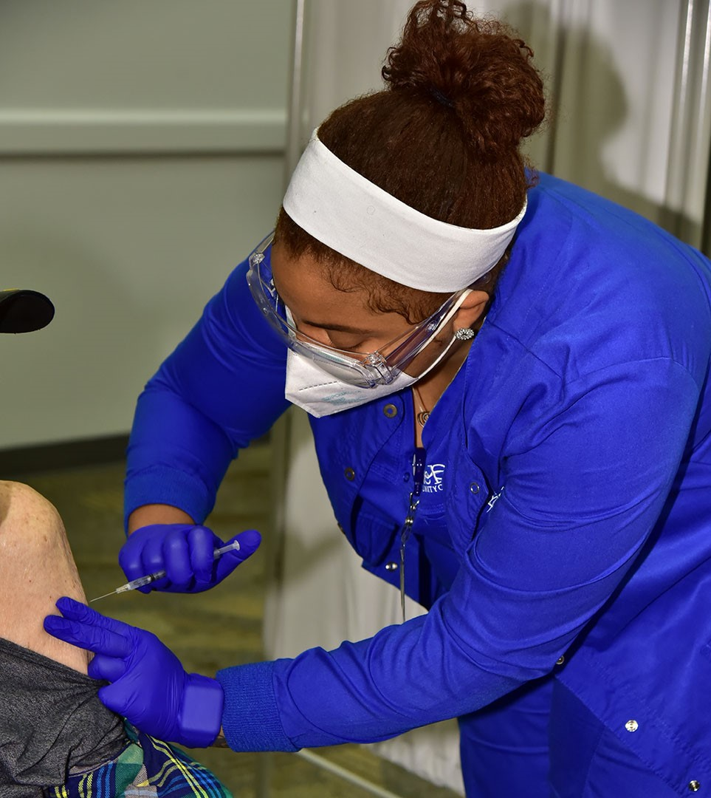
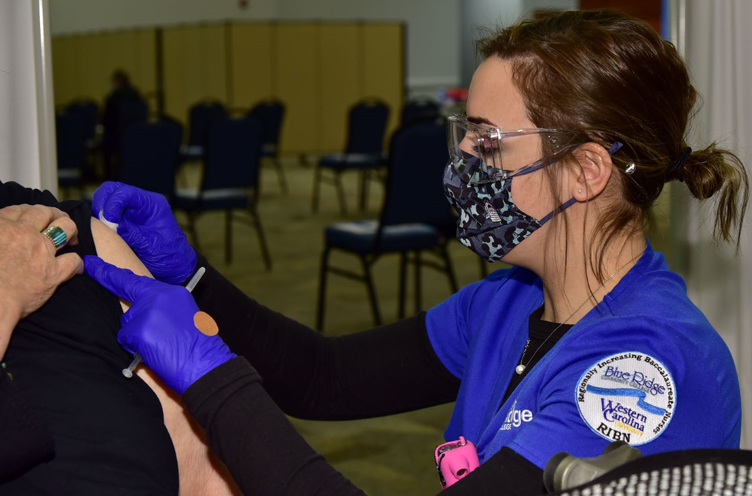
Blue Ridge Community College
Blue Ridge Community College stepped forward to provide critical pandemic assistance to health care partners such as the Henderson County Department of Public Health and Pardee UNC Health Care.
Without hesitation, they offered their facilities and in many cases, their staff, to provide drive-thru testing and vaccination options to our community.
They felt it was critical for their leaders to lead shoulder-to-shoulder with our partners in the community. This coordinated response kept their 115 employees, nursing students, and volunteers organized and involved in solving many challenges never faced before.
In the end, the collaboration resulted in nearly 28,000 vaccine doses administered to over 14,000 people in western North Carolina.

Slide 4
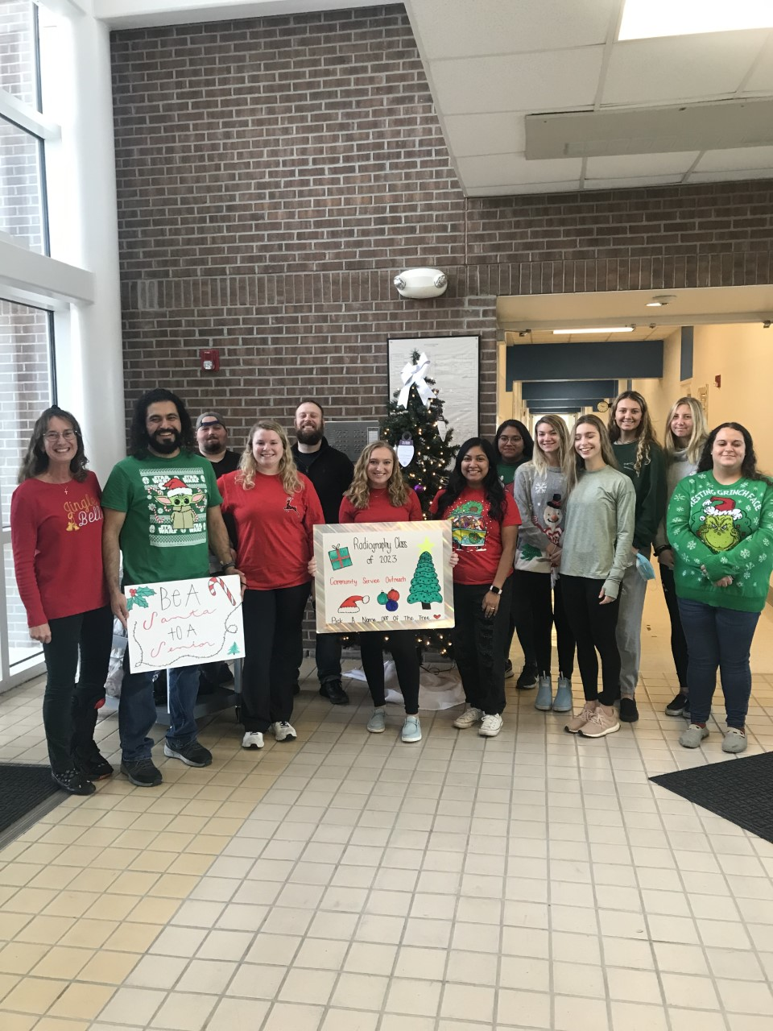
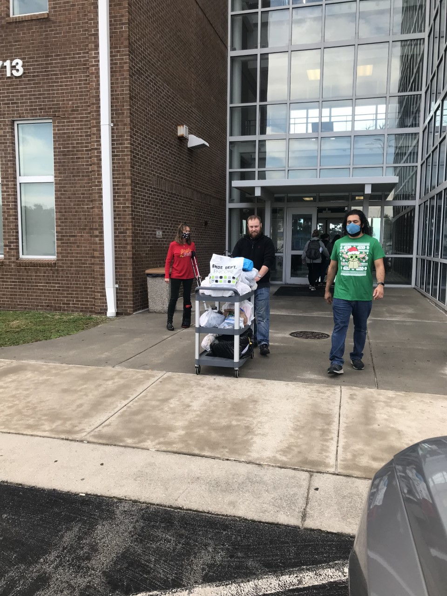
Carteret Community College
In November and December of 2021, the class of 2023 Radiography students partnered with Home Instead Senior Care Agency.
They put up a Christmas tree in the building that houses Radiography at CCC, the Radiography students received angel tags from the agency to place on the tree.
The students monitored the tree and collected the gifts/ donations collected from CCC staff, faculty and students. This was done 4 different times between Thanksgiving and Christmas 2021.
Over 70 Christmas gifts were collected and delivered to elderly residents in the three county area that Carteret Community College serves.

Slide 5
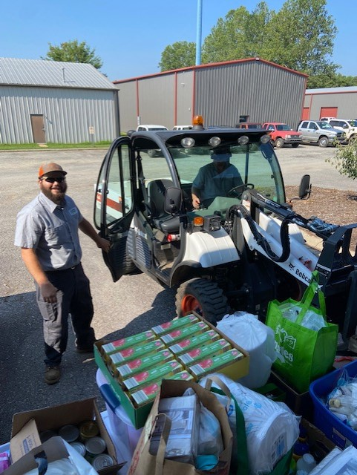
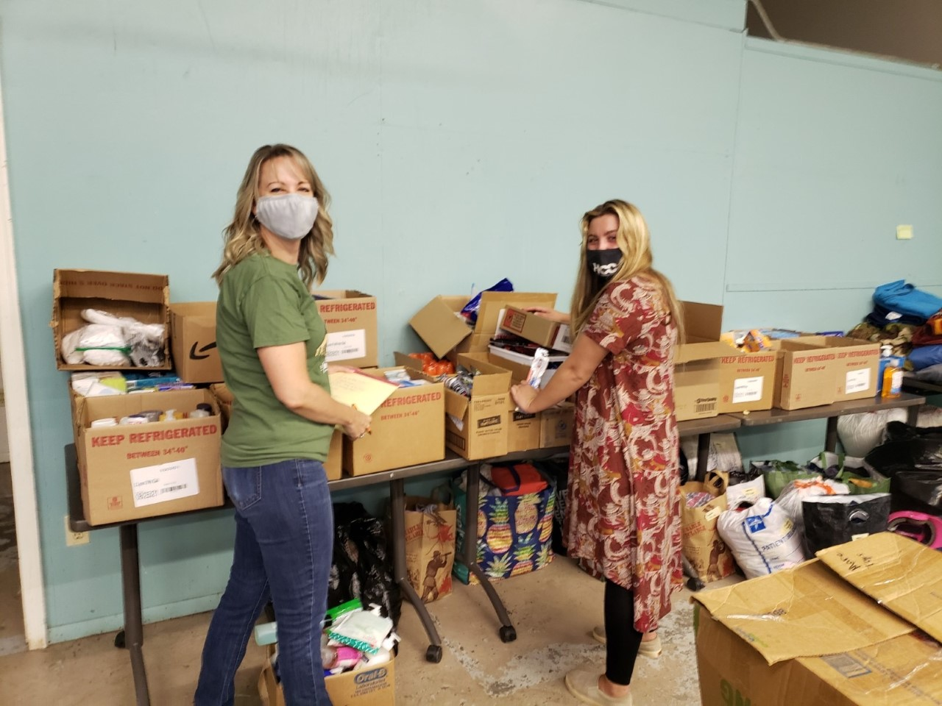
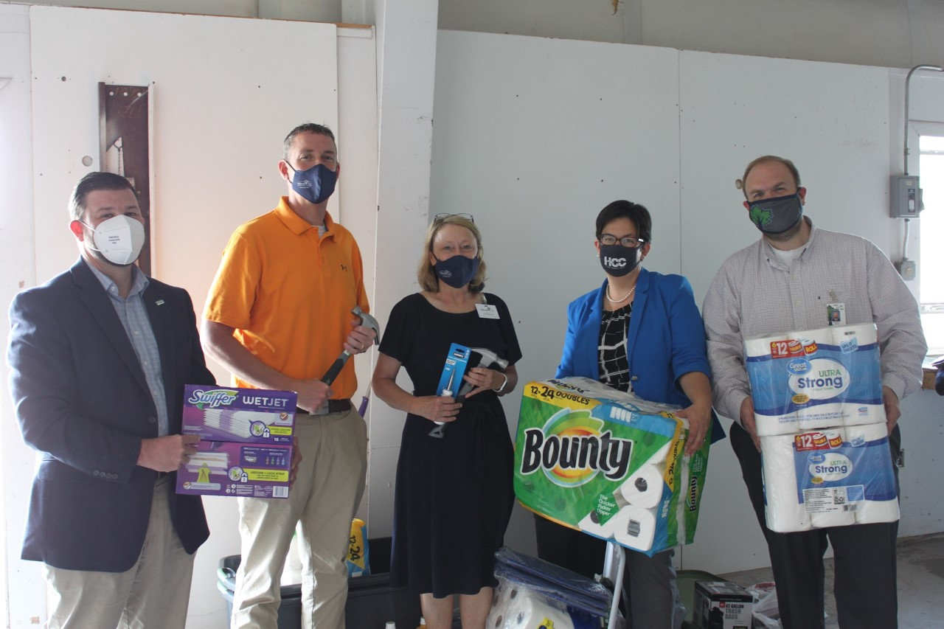
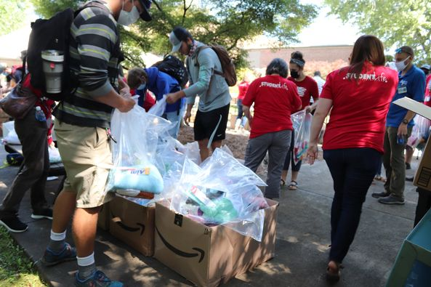
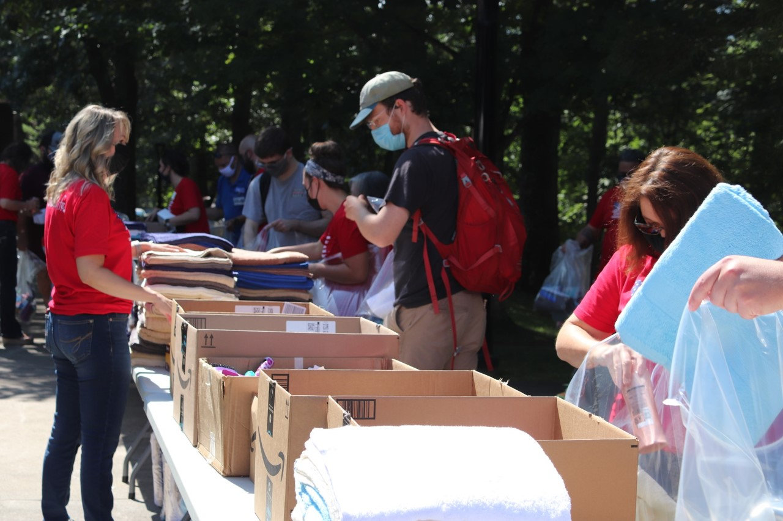
Haywood Community College
Haywood County and much of Western part of North Carolina were heavily impacted in 2021 by Hurricane Fred. So not only was this community dealing with the global pandemic that was impacting us all, this community and many in the path of Hurricane Fred were dealing with the devasting floods in August 2021 that severely impacted the communities served by Haywood Community College.
Non perishable foods, home essentials, and hygiene products were donated and collected during this time and much of HCC came to offer support!

Slide 6
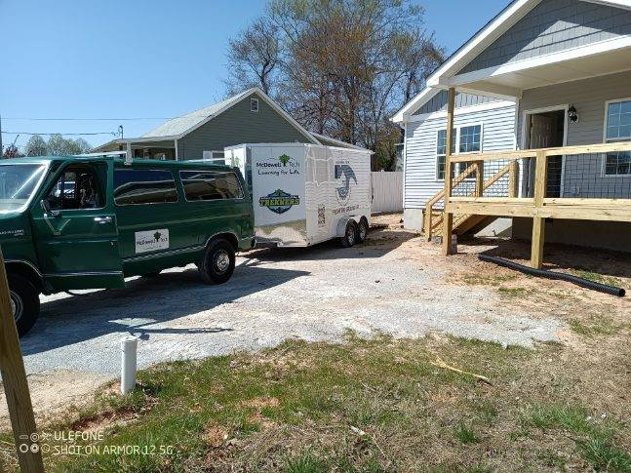
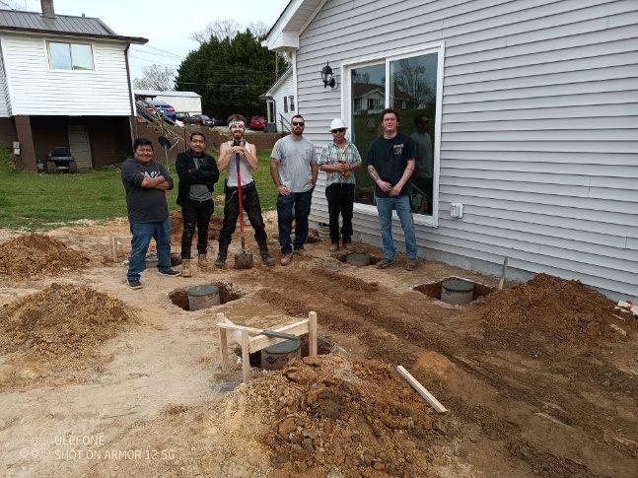
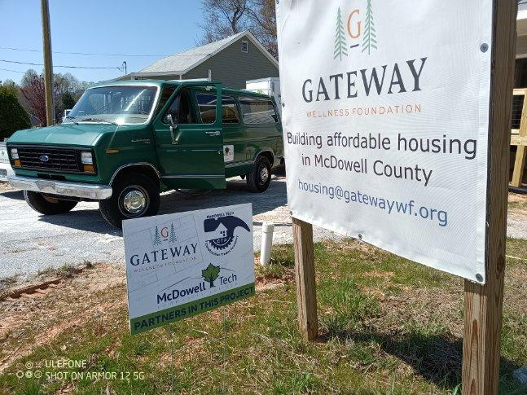
McDowell Technical Community College
McDowell Technical Community College partnered with two non-profit organizations that are doing great work in their community.
Recognizing the enormous need for affordable housing, over the last few years Dogwood Health Trust and Gateway Wellness Foundation have purchased land in McDowell County in an effort to begin developing communities of manufactured housing.
The homes are purchased through Dogwood Health Trust grant funds through Gateway Wellness Foundation. Gateway contracts with installers to have the homes put in place.
It was determined there was a real need for construction workers and especially project managers to help prepare sites and complete the finishing of the homes once they are in place.
Gateway and Dogwood partnered with MTCC to begin a Construction Trades Academy. The grant provided to MTC provided a full-time instructor and all equipment for the program.

