Slide 1
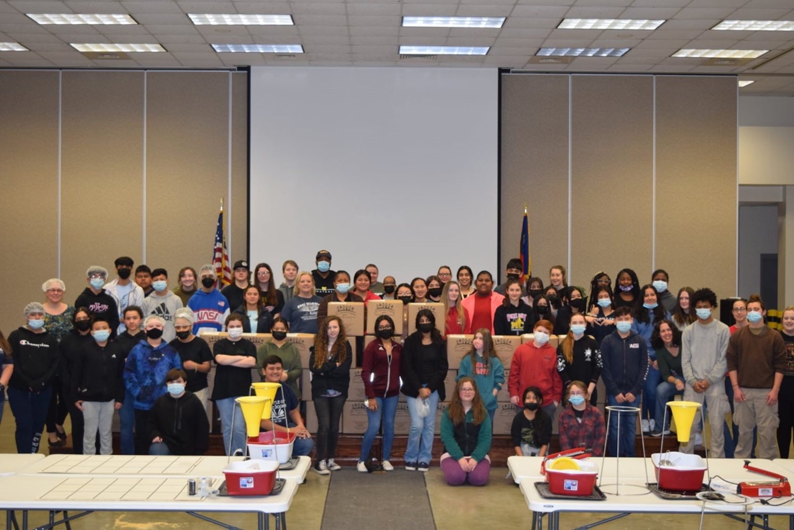
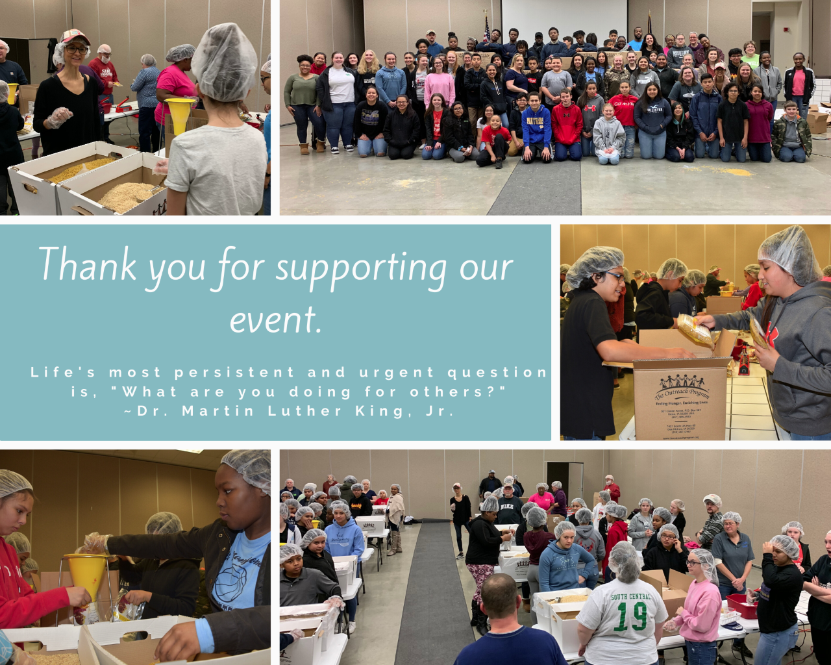
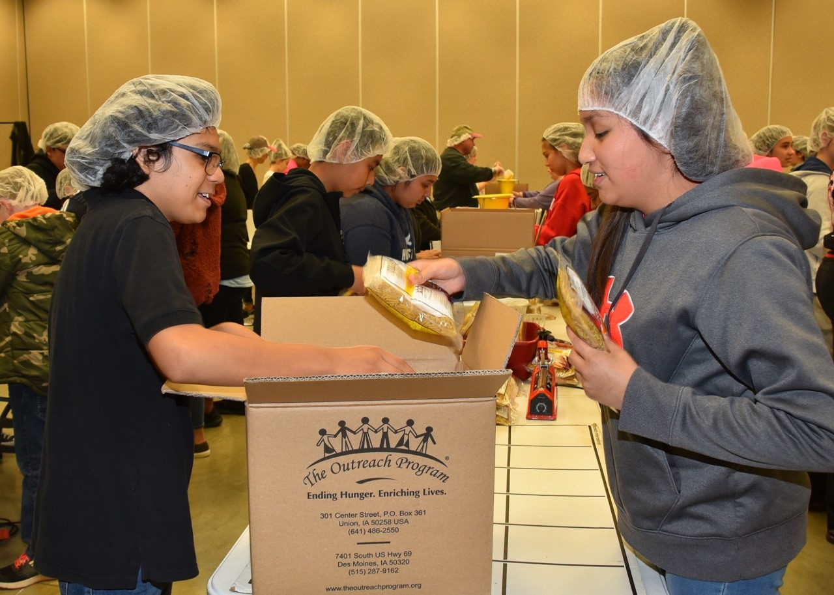
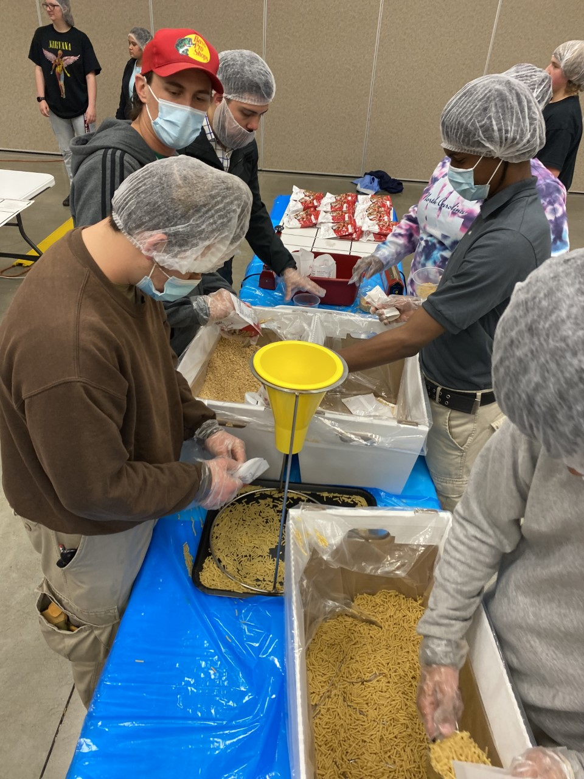
Montgomery Community College
In honor of Martin Luther King, Jr. Day, Montgomery Community College collaborates each January with Montgomery County Cooperative Extension, Communities in Schools and Eckerd Connect to host a MLK Day service event.
Students, faculty, staff and county citizens volunteer on their day off to serve their community.
For the past 4 years, they have hosted a meal packaging event on this day.
High school and college students along with faculty, staff, board members, 4-H members, residents from Eckerd Connect and community leaders work together to package between 10,000 - 15,000 meals.
All the meals created are distributed to the various food pantries in our county and to our Communities in Schools Backpack Pals program.
MCC has approximately 100 volunteers each year and receive generous funding from numerous donors, like the Montgomery Community College Foundation, to make the event such a big success!

Slide 2
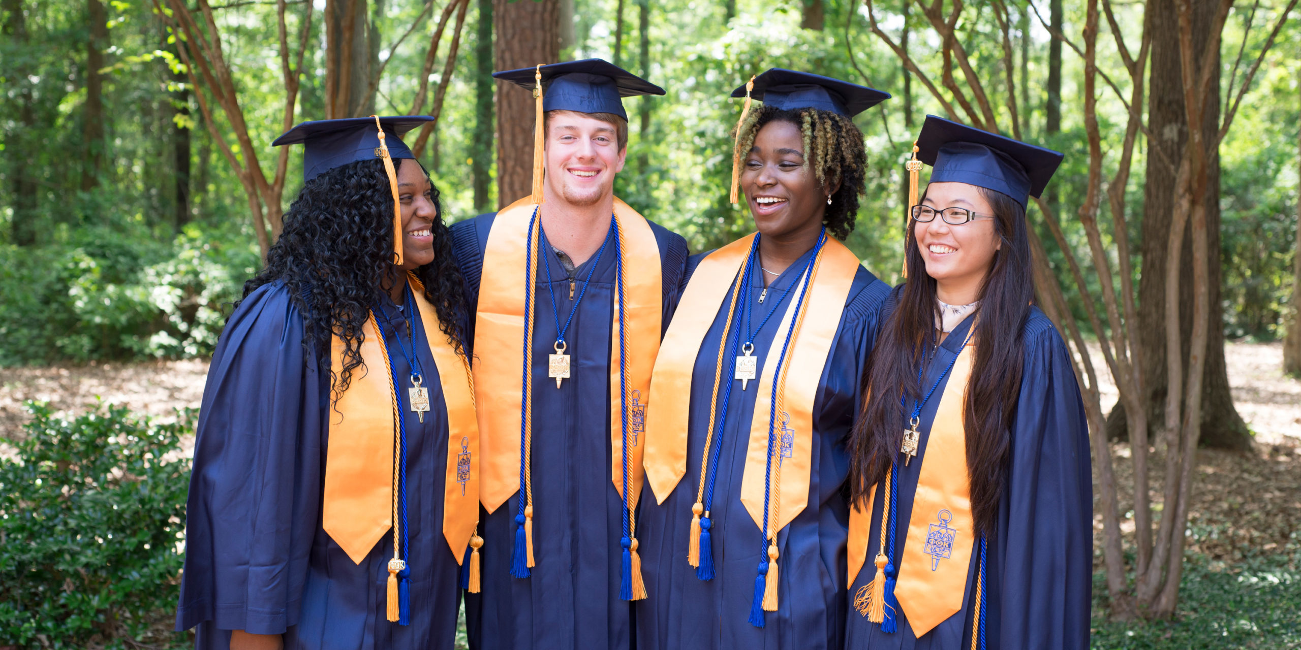
Pitt Community College
The PCC honor society, Phi Theta Kappa (PTK) did quite a bit of student outreach, community service and service-type events during the pandemic time period.
At the onset of the pandemic, they hosted a virtual talent show that later become known as Virtual Voices. This was a great way to build unity and connections during a time of isolation and working/ school from home. (2020)
Pet food and pet clothing donation drive. (2020)
PTK members contacted a list of 30 – 60 students each by email offering a Zoom appointment and lists a list of campus resources available to students. 100’s of students benefited from this amazing resource. (2021)

Slide 3
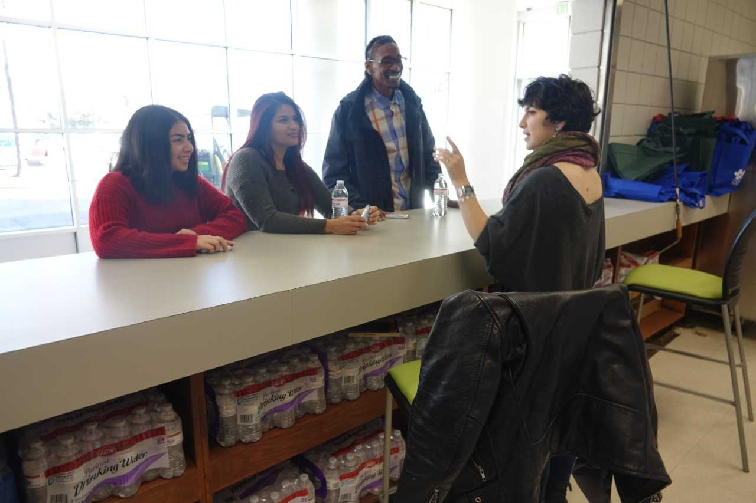
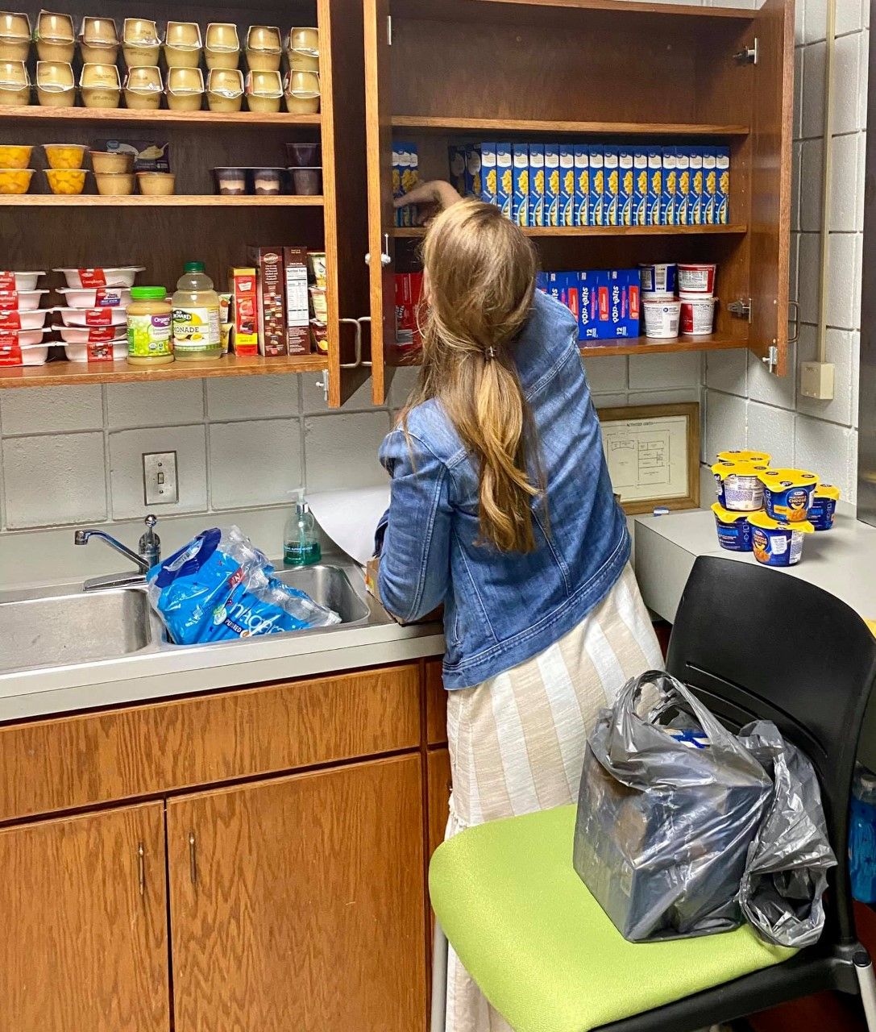
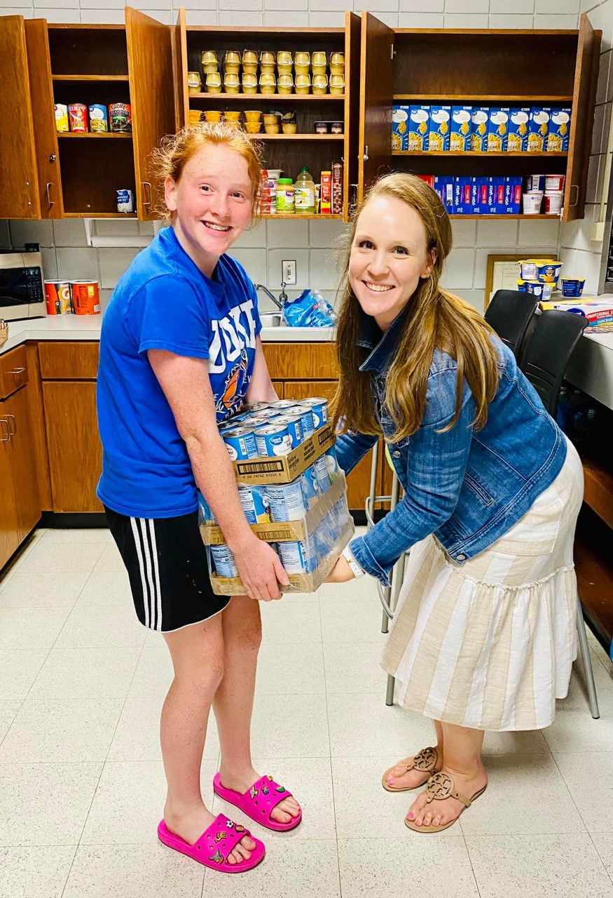
Sampson Community College
Sampson’s food pantry, Viking Fuel Pantry, was opened on November 13th 2018 after it was determined that their was a need on the campus.
During the pandemic faculty, staff, and students continued their efforts to continue supporting this wonderful service.
The mission of the Viking Fuel Pantry is simply “to provide momentary food assistance to SCC students at no cost.”

Slide 4
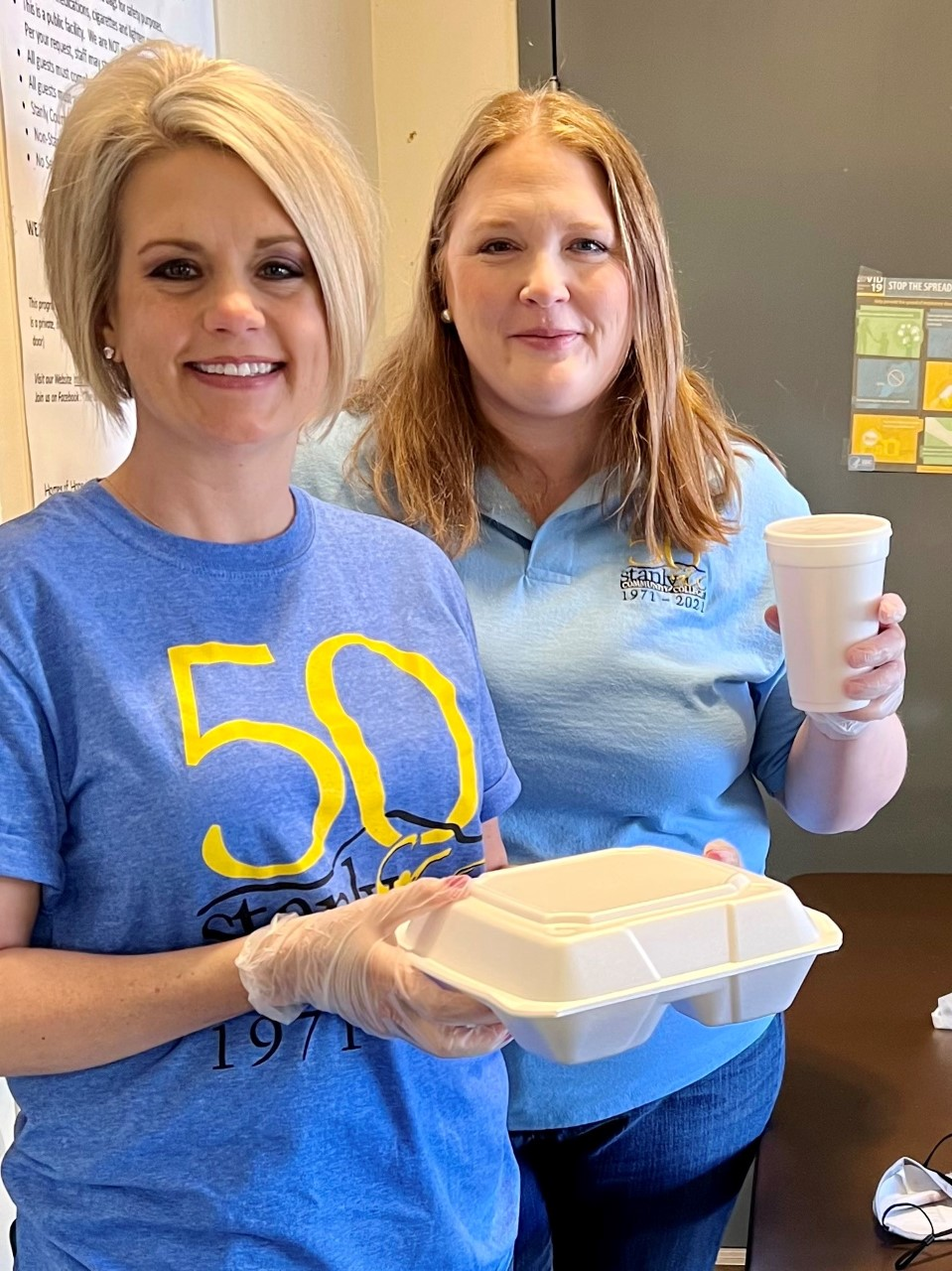
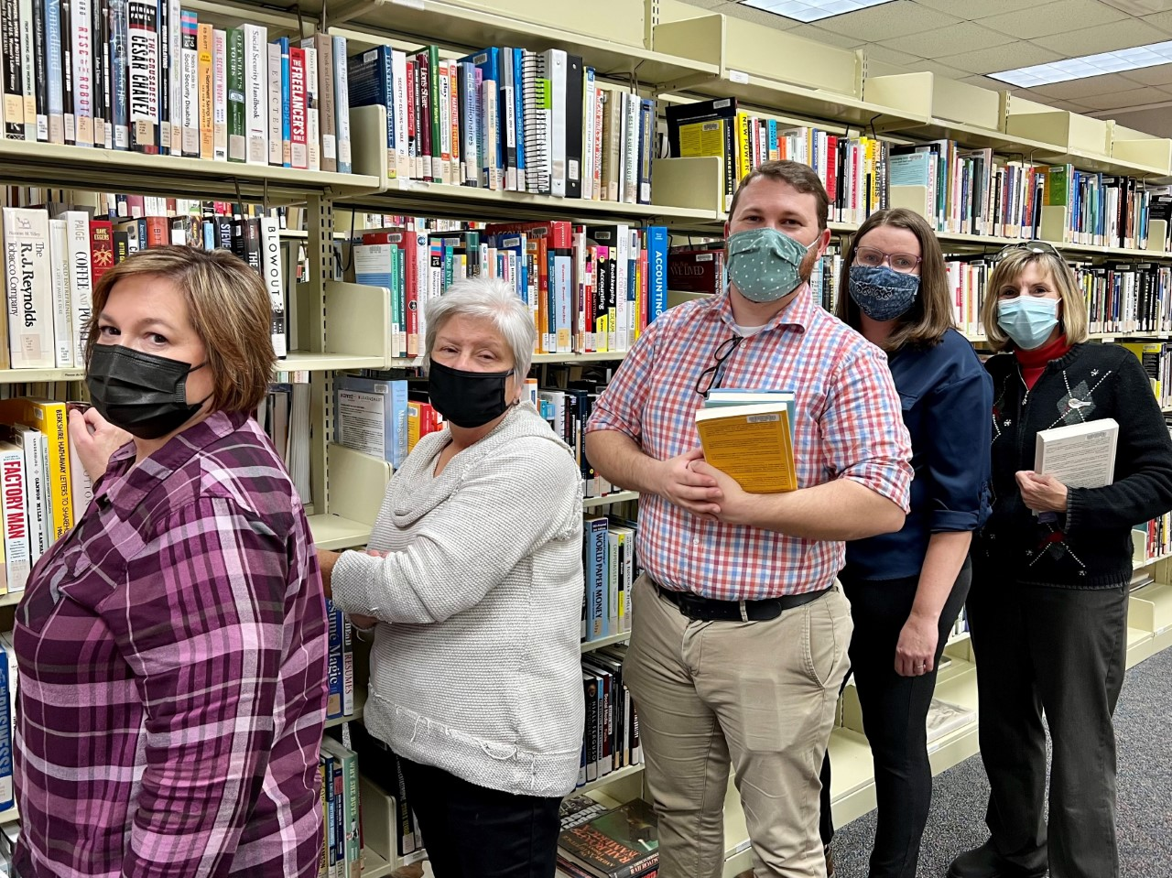
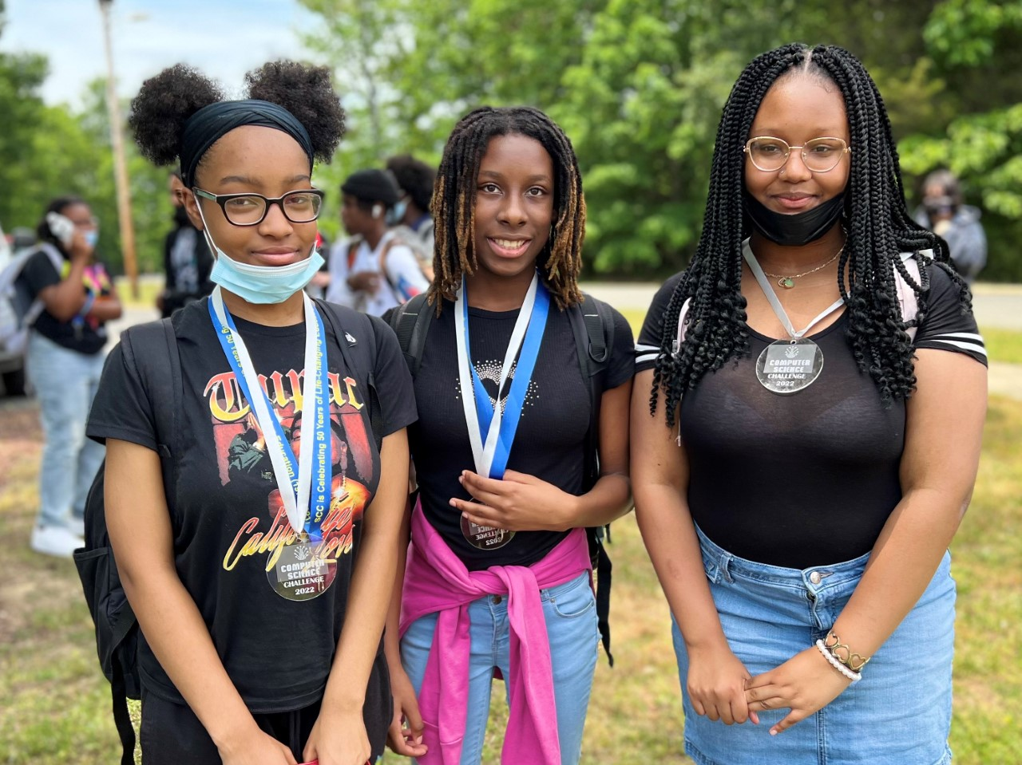
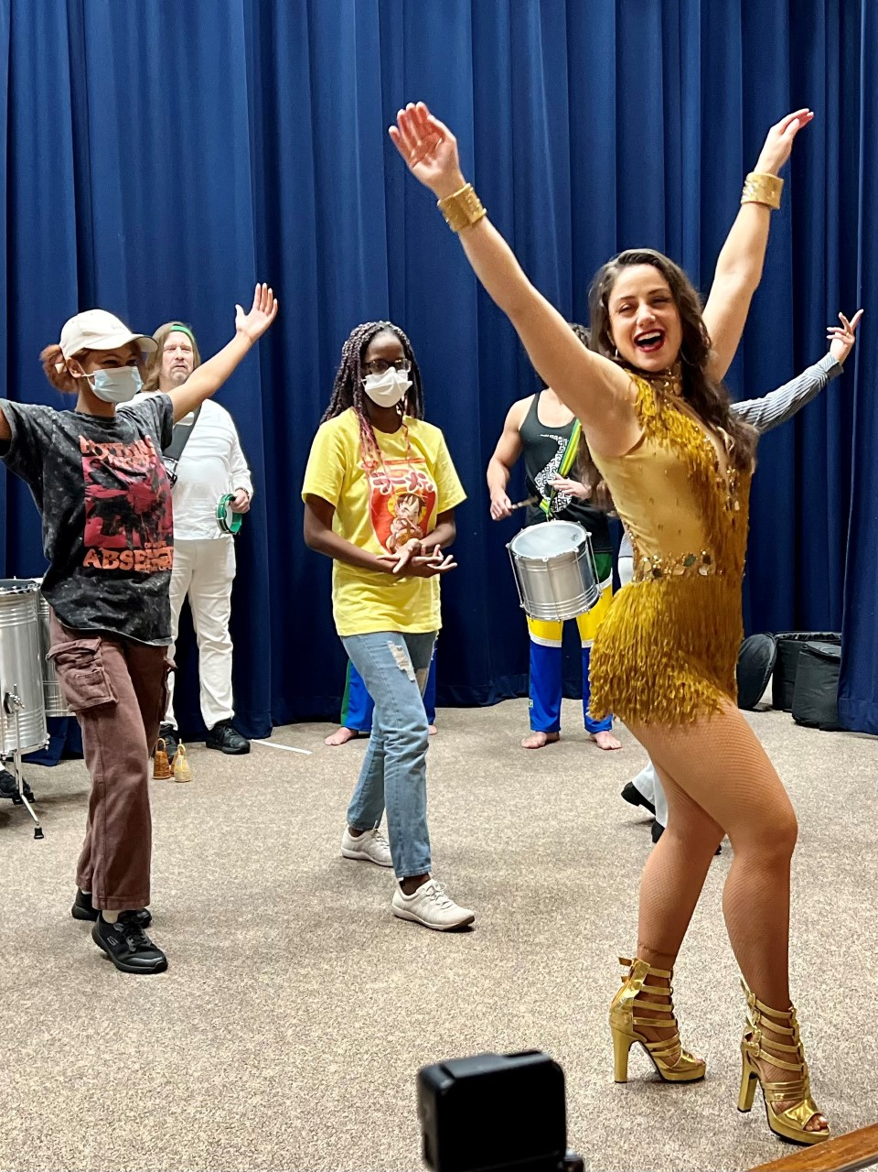
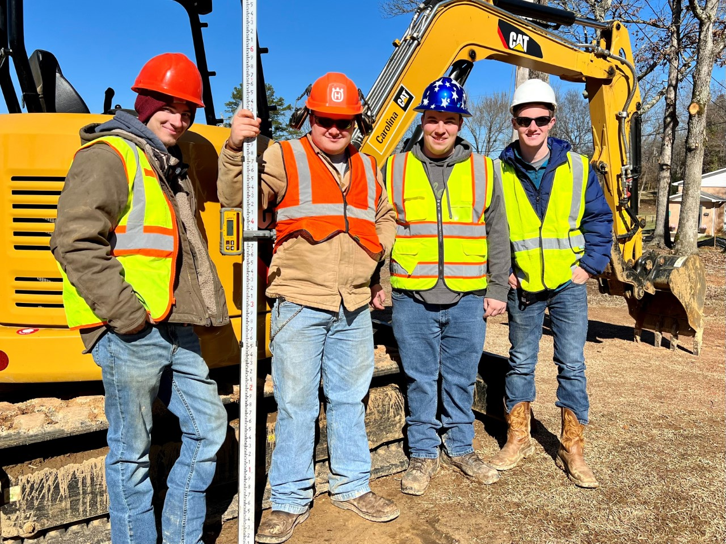
Stanly Community College
Stanly Community College continues its commitment to service to their community.
Serving meals at Stanly Community Christian Ministry's Community Table.
In partnership with the city of Albemarle, SCC’s Heavy Equipment Operations students completed the grading and site work a parking lot at the EE Waddell Community Center.
The Stanly Community College Library, in partnership with the Stanly County Public Library and the Pfeiffer University Library presented “Stanly Strong—Crucial Conversations in a Post-Pandemic World.”
SCC Turned 50 during the pandemic in July of 2021. During this time they celebrated with their community and offered various 50th Anniversary celebrations events.
SCC hosted the NC Brazilian Arts Project and invited the community to see demonstrations of Samba and Capoeira dance.

Slide 5
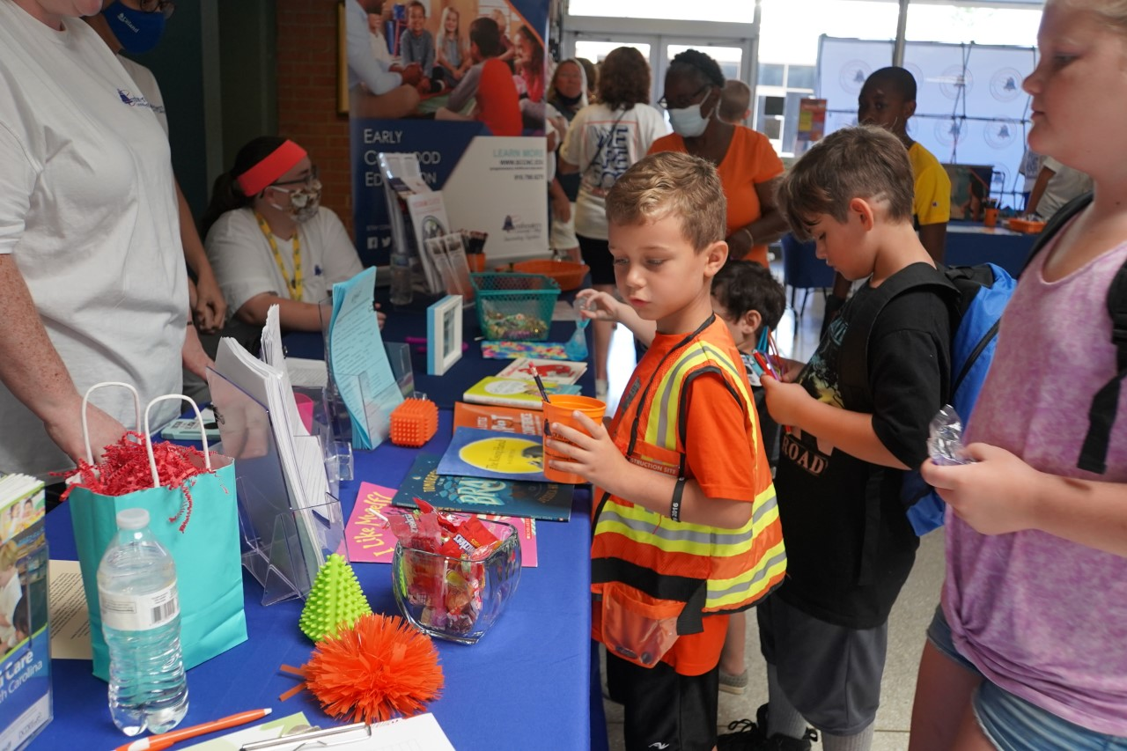
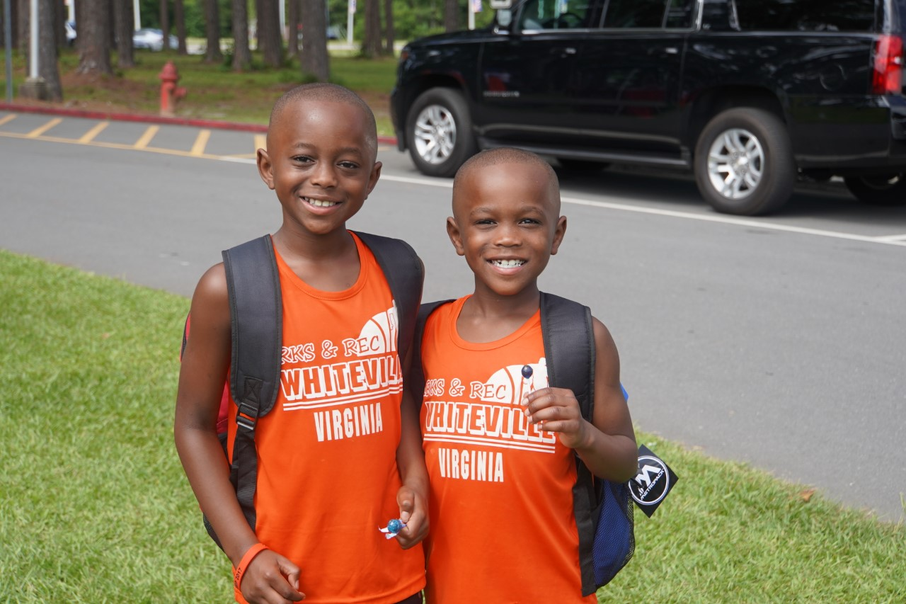
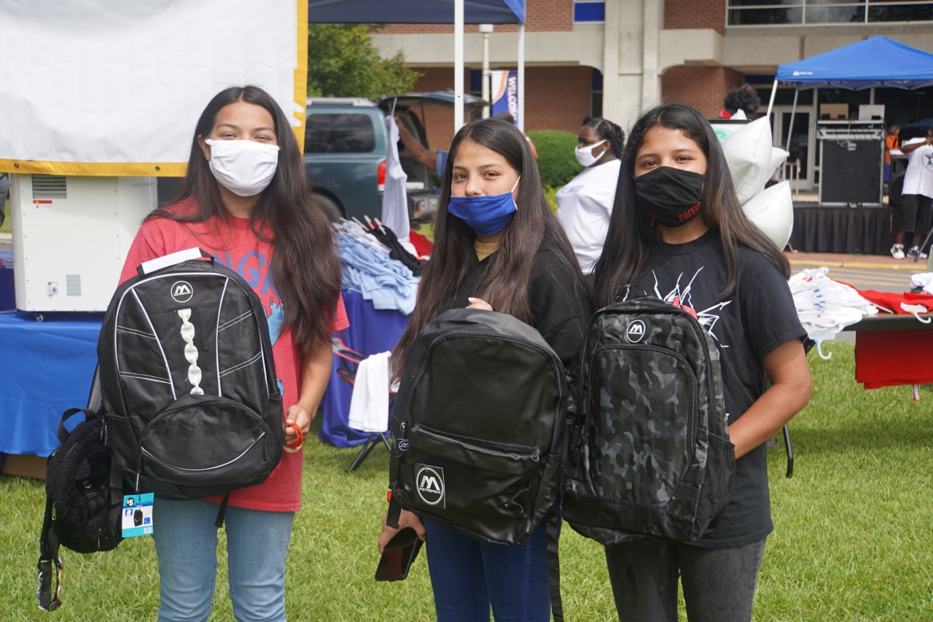
Southeastern Community College
In Fall 2021 SCC partnered with Chris Wilcox, former NBA player and Columbus County native to host a Chris Wilcox Family Fun Day.
The Family Fun Day was a health awareness event held on the college campus.
They had a COVID-19 vaccination clinic, college resources, provided backpacks and uniforms to K-12 students returning back to school face-2-face after virtual learning during the pandemic.
At this event, SCC had healthcare partners like Trillium and the American Heart Association on site to discuss the importance of mental health and overall heart health.

Slide 6
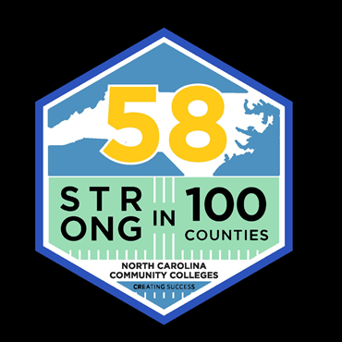
Always remember, we ARE….

Slide 7
THE WAY TO GET STARTED IS TO QUIT TALKING AND BEGIN DOING.
Walt Disney

